Slide 1
Introduction to Gradle
Koby aharon
April 2015

Slide 2
A little about me
Developer in the DI lab (iSpreads team)
Joined Citi about 5 months ago
Worked as a build manager in previous job
5+ years of experience with java build tools

Slide 3
Agenda
Build tools overview
Ant
Maven
Why Gradle?
Personal story
Gradle overview
Demo
Summary

Slide 4
Build Tools Overview

Slide 5

Ant - Overview
Java based build tool from Apache
Started as part of Tomcat
Moved to a separate project in early 2000
Imperative build tool
Files are written in XML
Notes:
Imperative – You need to tell the tool exactly what to do and also how to do it. Very verbose.

Slide 6

What does it take to build a java app?
Download 3rd party dependencies
Compile source code
Run tests - optional
Create distribution file (jar)

Slide 7
Ant - Build file example
<project name=“example” default= basedir=".">
<property name="src" location="src"/>
<property name="build" location="build"/>
<property name="dist" location="dist"/>
<target name=“clean”>
<delete dir=“${build}”/>
<mkdir dir="${build}"/>
</target>
<target name=“compile” depends= >
<javac srcdir="${src}" destdir="${build}"/>
</target>
<target name=“dist” depends= >
<mkdir dir="${dist}/lib"/>
<jar jarfile="${dist}/lib/example.jar"
basedir="${build}"/>
</target>
</project>
”dist”
dist
Input: compiled code + output paths
Output: jar file
compile
Input: source + compiled code paths
Output: compiled files
”clean”
”compile”
clean
Input: compiled code path
Output: empty folder

Slide 8


What does it takes to build a java app?
Download 3rd party dependencies
Compile source code
Run tests - optional
Create distribution file (jar)

Slide 9
Ant – Pros/Cons
Pros
Very easy to learn.
Full control over the build process.
No “magic”
Cons
Most builds contain huge XML files
Hard to maintain
XML format to write “code”
No convention

Slide 10

Maven - Overview
Released in 2004
Most popular java build tool
Declarative build tool
Introduced dependency management
Introduced multi-module builds
Relies on convention over configuration
Uses plugin architecture
Files are written in XML
Notes:
Declarative - You describe your project and the aspects of it and the tool does all the work.

Slide 11
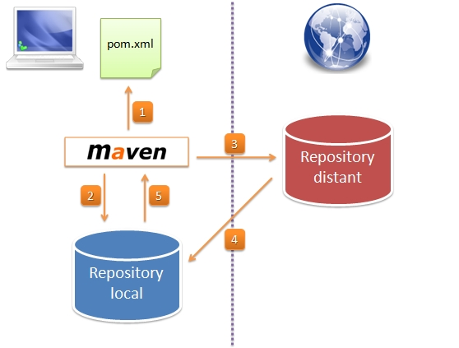
Maven – architecture
Notes:
Maven build life cycles:
1. clean → pre-clean,clean,post-clean
2. default (build)
3. site → pre-site, site, post-site, site-deploy

Slide 12
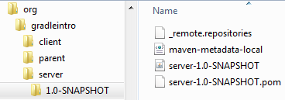
Maven – dependency management
Every module has 3 required fields defining his “address”:
groupId – a unique namespace (usually the company name)
artifactId – the artifact’s name (matches the jar name)
version – the artifact’s version
Example:
<groupId>org.gradleintro</groupId>
<artifactId>server</artifactId>
<version>1.0-SNAPSHOT</version>

Slide 13
Maven – key features
Simple project setup that follows best practices
Extensible via plugins
Defines build lifecycles and phases. Plugin goals are attached to defined phases.
Declarative over imperative
Consist usage across all projects
Dependency management (no need to commit jars to SCM)
Multi module support

Slide 14
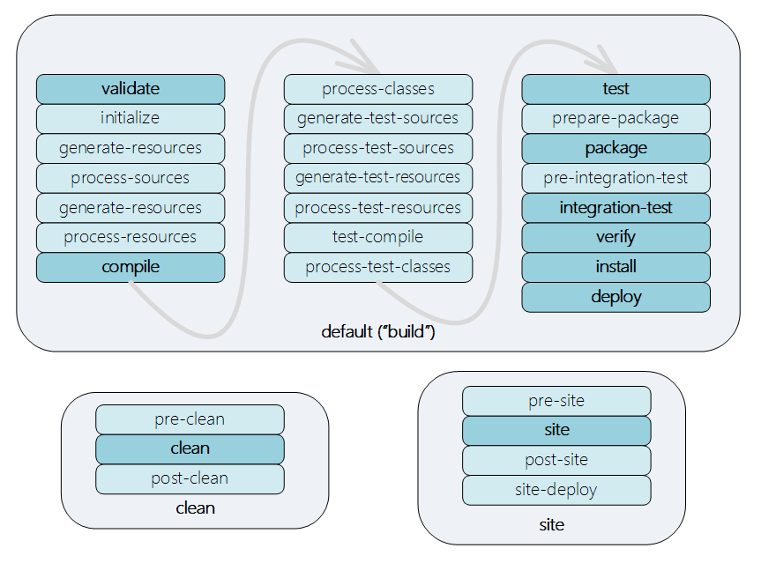
Maven – build lifecycles

Slide 15
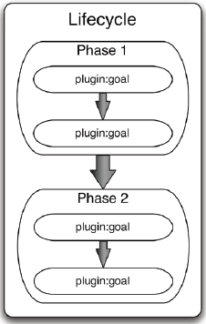
Maven – build lifecycles
Lifecycle represents a well recognized steps (Phases) used in software assembly
Each step in a lifecycle is called a phase. Zero or more plugin goals are bound to a phase.

Slide 16
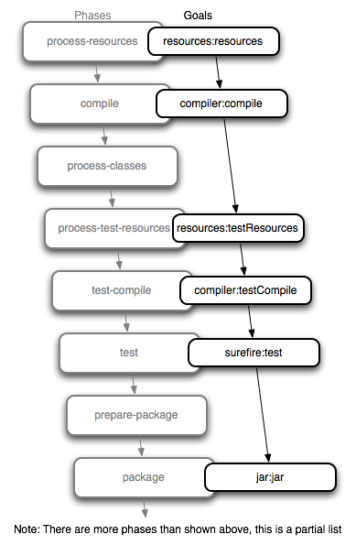
Maven – default (build) lifecycle
Notes:
Maven build life cycles:
1. clean → pre-clean,clean,post-clean
2. default (build)
3. site → pre-site, site, post-site, site-deploy

Slide 17
Maven – POM example
<project>
<modelVersion>4.0.0</modelVersion>
<groupId>org.gradleintro</groupId>
<artifactId>example</artifactId>
<version>1.0-SNAPSHOT</version>
<packaging>jar</packaging>
<dependencies>
<dependency>
<groupId>junit</groupId>
<artifactId>junit</artifactId>
<version>4.11</version>
<scope>test</scope>
</dependency>
</dependencies>
</project>
Module’s
coordinates
Module’s
dependency
list

Slide 18
What does it takes to build a java app?
Download 3rd party dependencies
Compile source code
Run tests - optional
Create distribution file (jar)

Slide 19
Maven – POM example
<project>
<modelVersion>4.0.0</modelVersion>
<groupId>org.gradleintro.example</groupId>
<artifactId>example</artifactId>
<version>1.0-SNAPSHOT</version>
<packaging>jar</packaging>
<name>Maven Example POM file</name>
<dependencies>
<dependency>
<groupId>junit</groupId>
<artifactId>junit</artifactId>
<version>4.8.2</version>
<scope>test</scope>
</dependency>
</dependencies>
</project>
Every build module is enclosed within a “project” tag
Module’s coordinates
Module’s dependency list

Slide 20
Why
Gradle?

Slide 21



why
another
Build
Tool?
Notes:
* Projects today contain a lot of different modules from different languages (polyglot build)
* Both Maven and ant presented key innovations, however today there are more demands from a build tool. (polyglot build, deployment pipelines, etc.)
* Most projects are very different than one another including their build requirements.

Slide 22
Gradle - Personal story
Worked on a multi-module Maven project containing more than 200 modules
Maven build times:
Full build without tests – 40 minutes
Full build with unit tests – 50 minutes
Full build with full tests suite (unit + integration + async) – 1:30 hours
Hybrid Gradle + Maven build time - 12 minutes (on average)
Example code is hosted on Github.

Slide 23

Gradle - Overview
First released in 2009
Project automation tool
Builds upon the concepts of Maven and Ant
Declarative as well as imperative
Files are written in Groovy using a dedicated DSL

Slide 24
Gradle – key features
Very flexible
Ease of migration
Declarative builds and build-by-convention
Multi-module support
Dependency management support (richer than Maven)
Gradle wrapper (simple installation)
Build files are written in Groovy
No build lifecycle. You define the task graph.

Slide 25
Gradle - build tools position
Ant
Maven
Gradle

Slide 26
Gradle – main entities
Project – Every build file in made up of one or more projects (can represent a jar file, war file, etc.)
Task – Represent atomic piece of work. Project contains multiple tasks while every task can have several actions.

Slide 27
Gradle – hello world example
build.gradle
task helloWorld {
doLast {
println “hello, world"
}
}
Define a new task called “helloWorld” with an action that
output “hello, world” to the console

Slide 28
Gradle – hello world example
task hello
task world
task helloWorld {
dependsOn = [ world, hello ]
}
world {
dependsOn << hello
doLast {
println "world"
}
}
hello {
doLast {
print "hello, "
}
}
Defines 2 tasks “hello” and “world”
Define another task “helloWorld” and
configures it’s task dependencies
Configure the previously defined “world” task
Add task “hello” to task “world” dependency list
(using Groovy’s “<<“ operator)
Add an activity to task “world” activity list. Task can contain
Multiple activities.
Configure the previously defined “hello” task
Add an activity to task “hello” activity list.

Slide 29
Gradle – build.gradle java module
apply plugin: 'java'
group = 'org.gradleintro'
version = '1.0-SNAPSHOT'
dependencies {
testCompile 'junit:junit:4.11'
}
<project>
…
<groupId>org.gradleintro</groupId>
<artifactId>example</artifactId>
<version>1.0-SNAPSHOT</version>
<packaging>jar</packaging>
<dependencies>
<dependency>
<groupId>junit</groupId>
<artifactId>junit</artifactId>
<version>4.11</version>
<scope>test</scope>
</dependency>
</dependencies>
</project>

Slide 30
DEMO

Slide 31
Gradle – Resources
Documentation:
User guide: http://www.gradle.org/docs/current/userguide/userguide.html
DSL:
http://www.gradle.org/docs/current/dsl/
Javadoc:
http://www.gradle.org/docs/current/dsl/
Groovy Doc:
http://www.gradle.org/docs/current/groovydoc/
Plugin search: https://plugins.gradle.org/

Slide 32
Gradle @Citi Innovation lab

Slide 33
Summary

Slide 34
Build Tools – Pros/Cons
 | Ant | Maven | Gradle
Pros | Easy to learn and use Full control over the build process. No “Magic” | Very good IDE support Standard build process Build files are mostly the same across different projects Lot of plugins | Very flexible Incremental build Large community Great documentation Groovy code Declarative as well as imperative Easy migration
Cons | Large XML files Hard to maintain XML format to write “code” Imperative build tool | Learning curve Not flexible Partial multi-module support Not optimal for large projects A lot of “Magic” | Fragile IDE support Learning curve Groovy code A lot of “Magic”
Notes:
Maven:
Partial multi module support -> modules are dependent as artifacts. For example if A depends on B, and you want to build only A, B will be searches for in the repository and won’t be build automatically (supported in Maven 3 using “–pl” and “–am”, however you need to explicitly list the module and can be executed only from the
root).

